Slide 1
New planner Option 1. Only add rectangular and circular chambers/grids; upgrade current Planner Option 2. Add arbitrary chambers/grids with CAD; need to redesign Planner

Slide 2
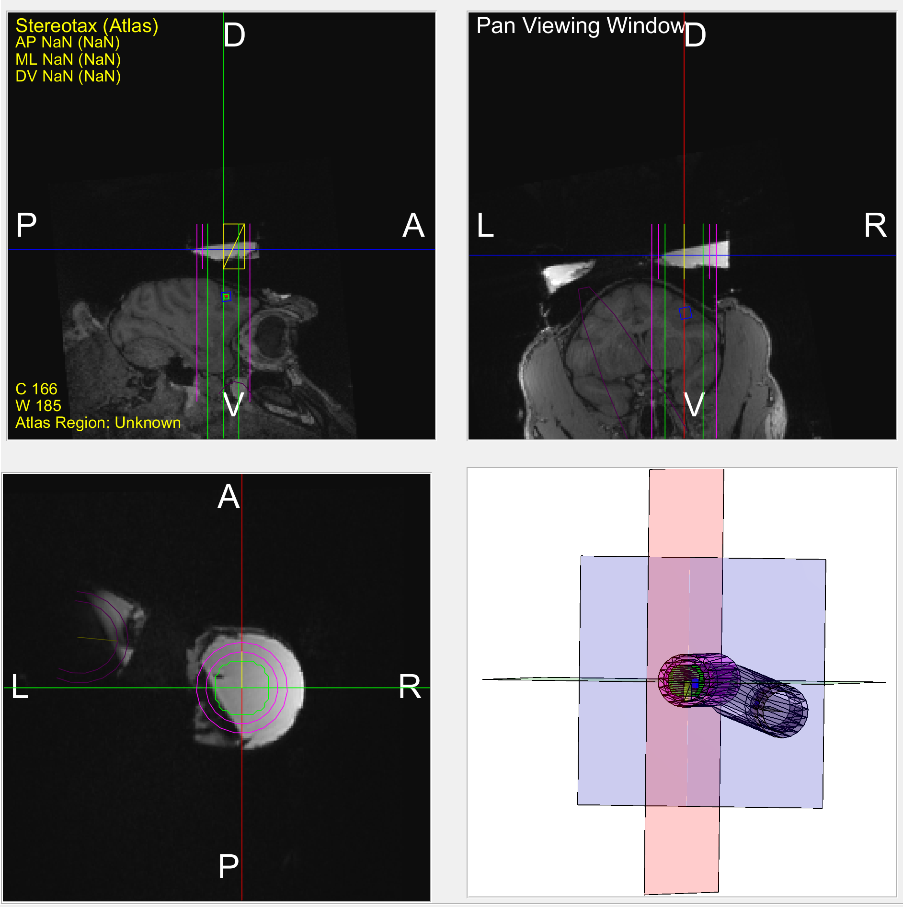
Option 1. upgrade current Planner with rectangular and circular chambers/grids
New feature #1:
Draw outlines of the new chamber in the 2D MRI views and the 3D mesh view.
E.g., New rectangular chamber

Slide 3
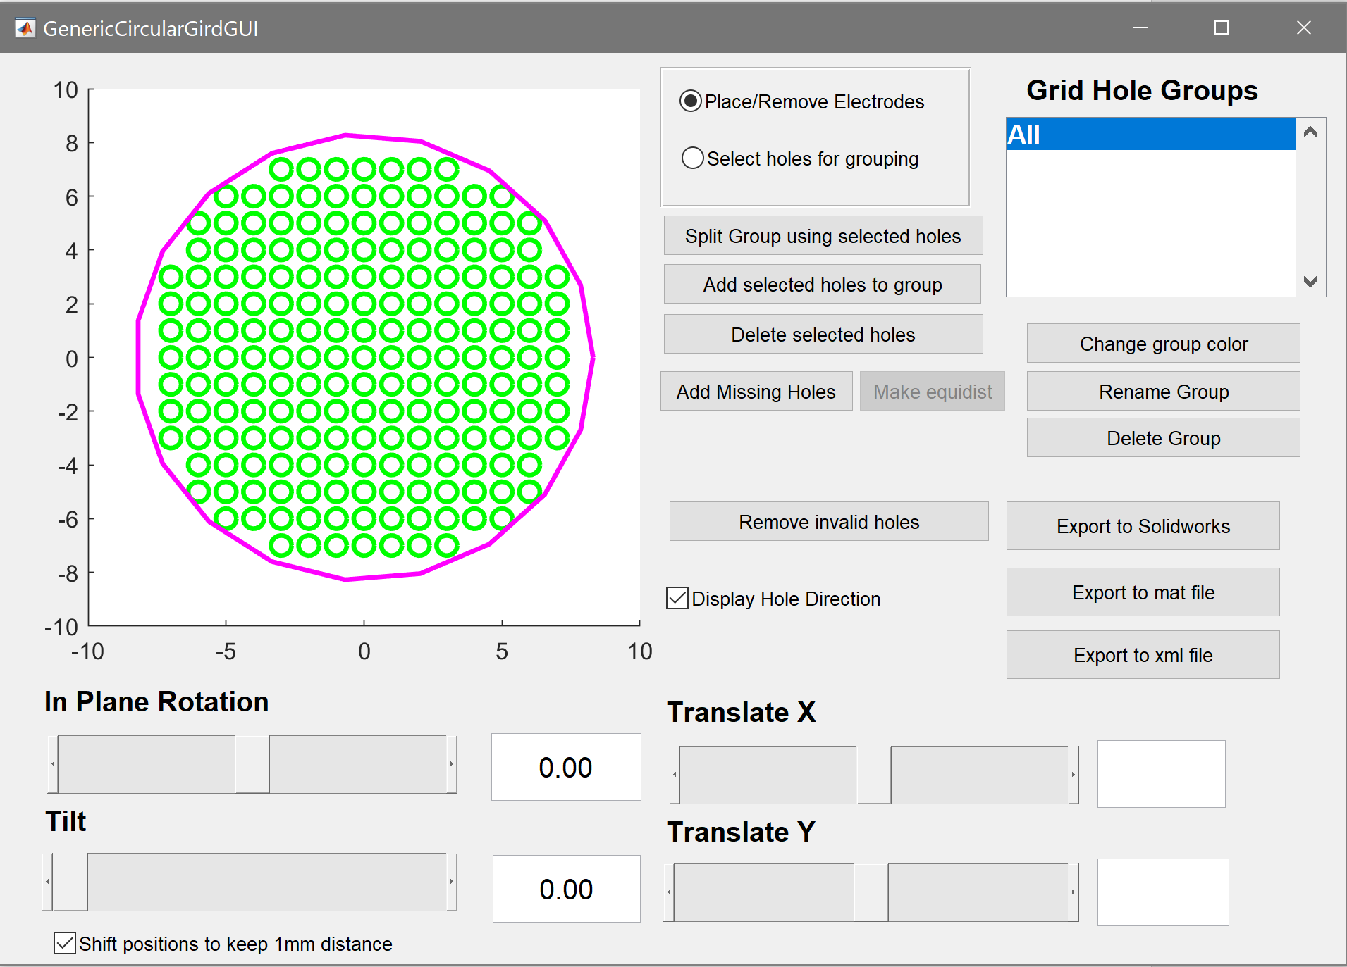
Option 1. upgrade current Planner with rectangular and circular chambers/grids
New feature #2:
Generate holes in rectangular and circular grids.
E.g., the boundary of a rectangular grid.

Slide 4
Option 1. upgrade current Planner with rectangular and circular chambers/grids
New feature #3:
Automatically generate a rectangular or circular grid with holes.

Slide 5
Option 2

Slide 6
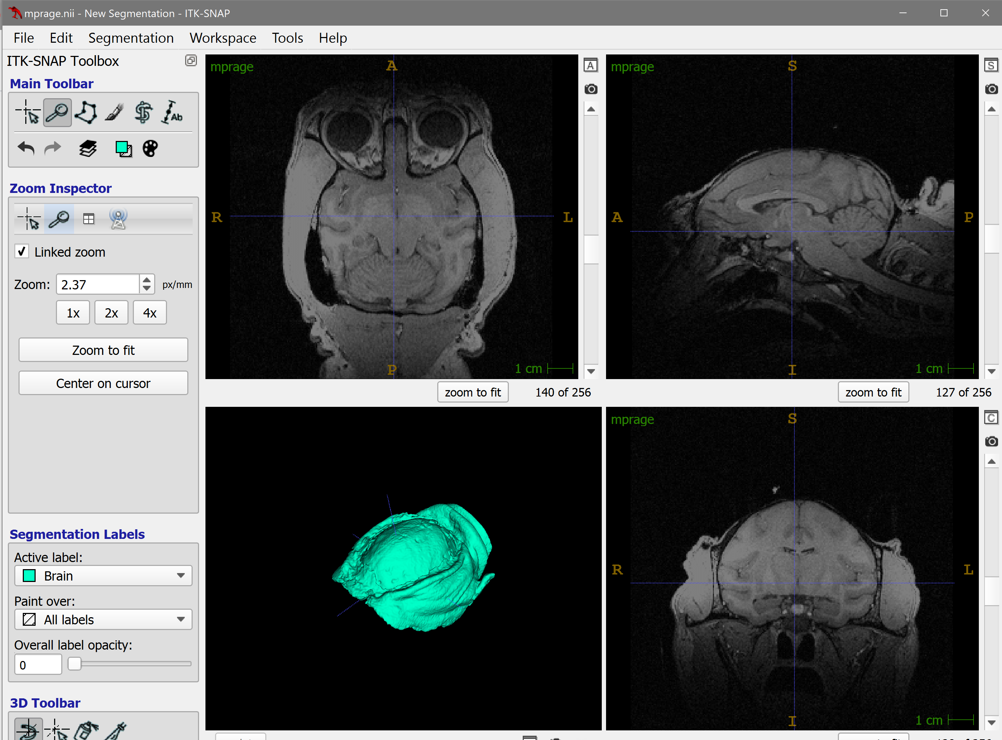
Option 2. Add arbitrary chambers/grids with CAD; need to redesign Planner based on ITK-SNAP and FreeCAD
Export the mesh as stl and reload it in FreeCAD

Slide 7
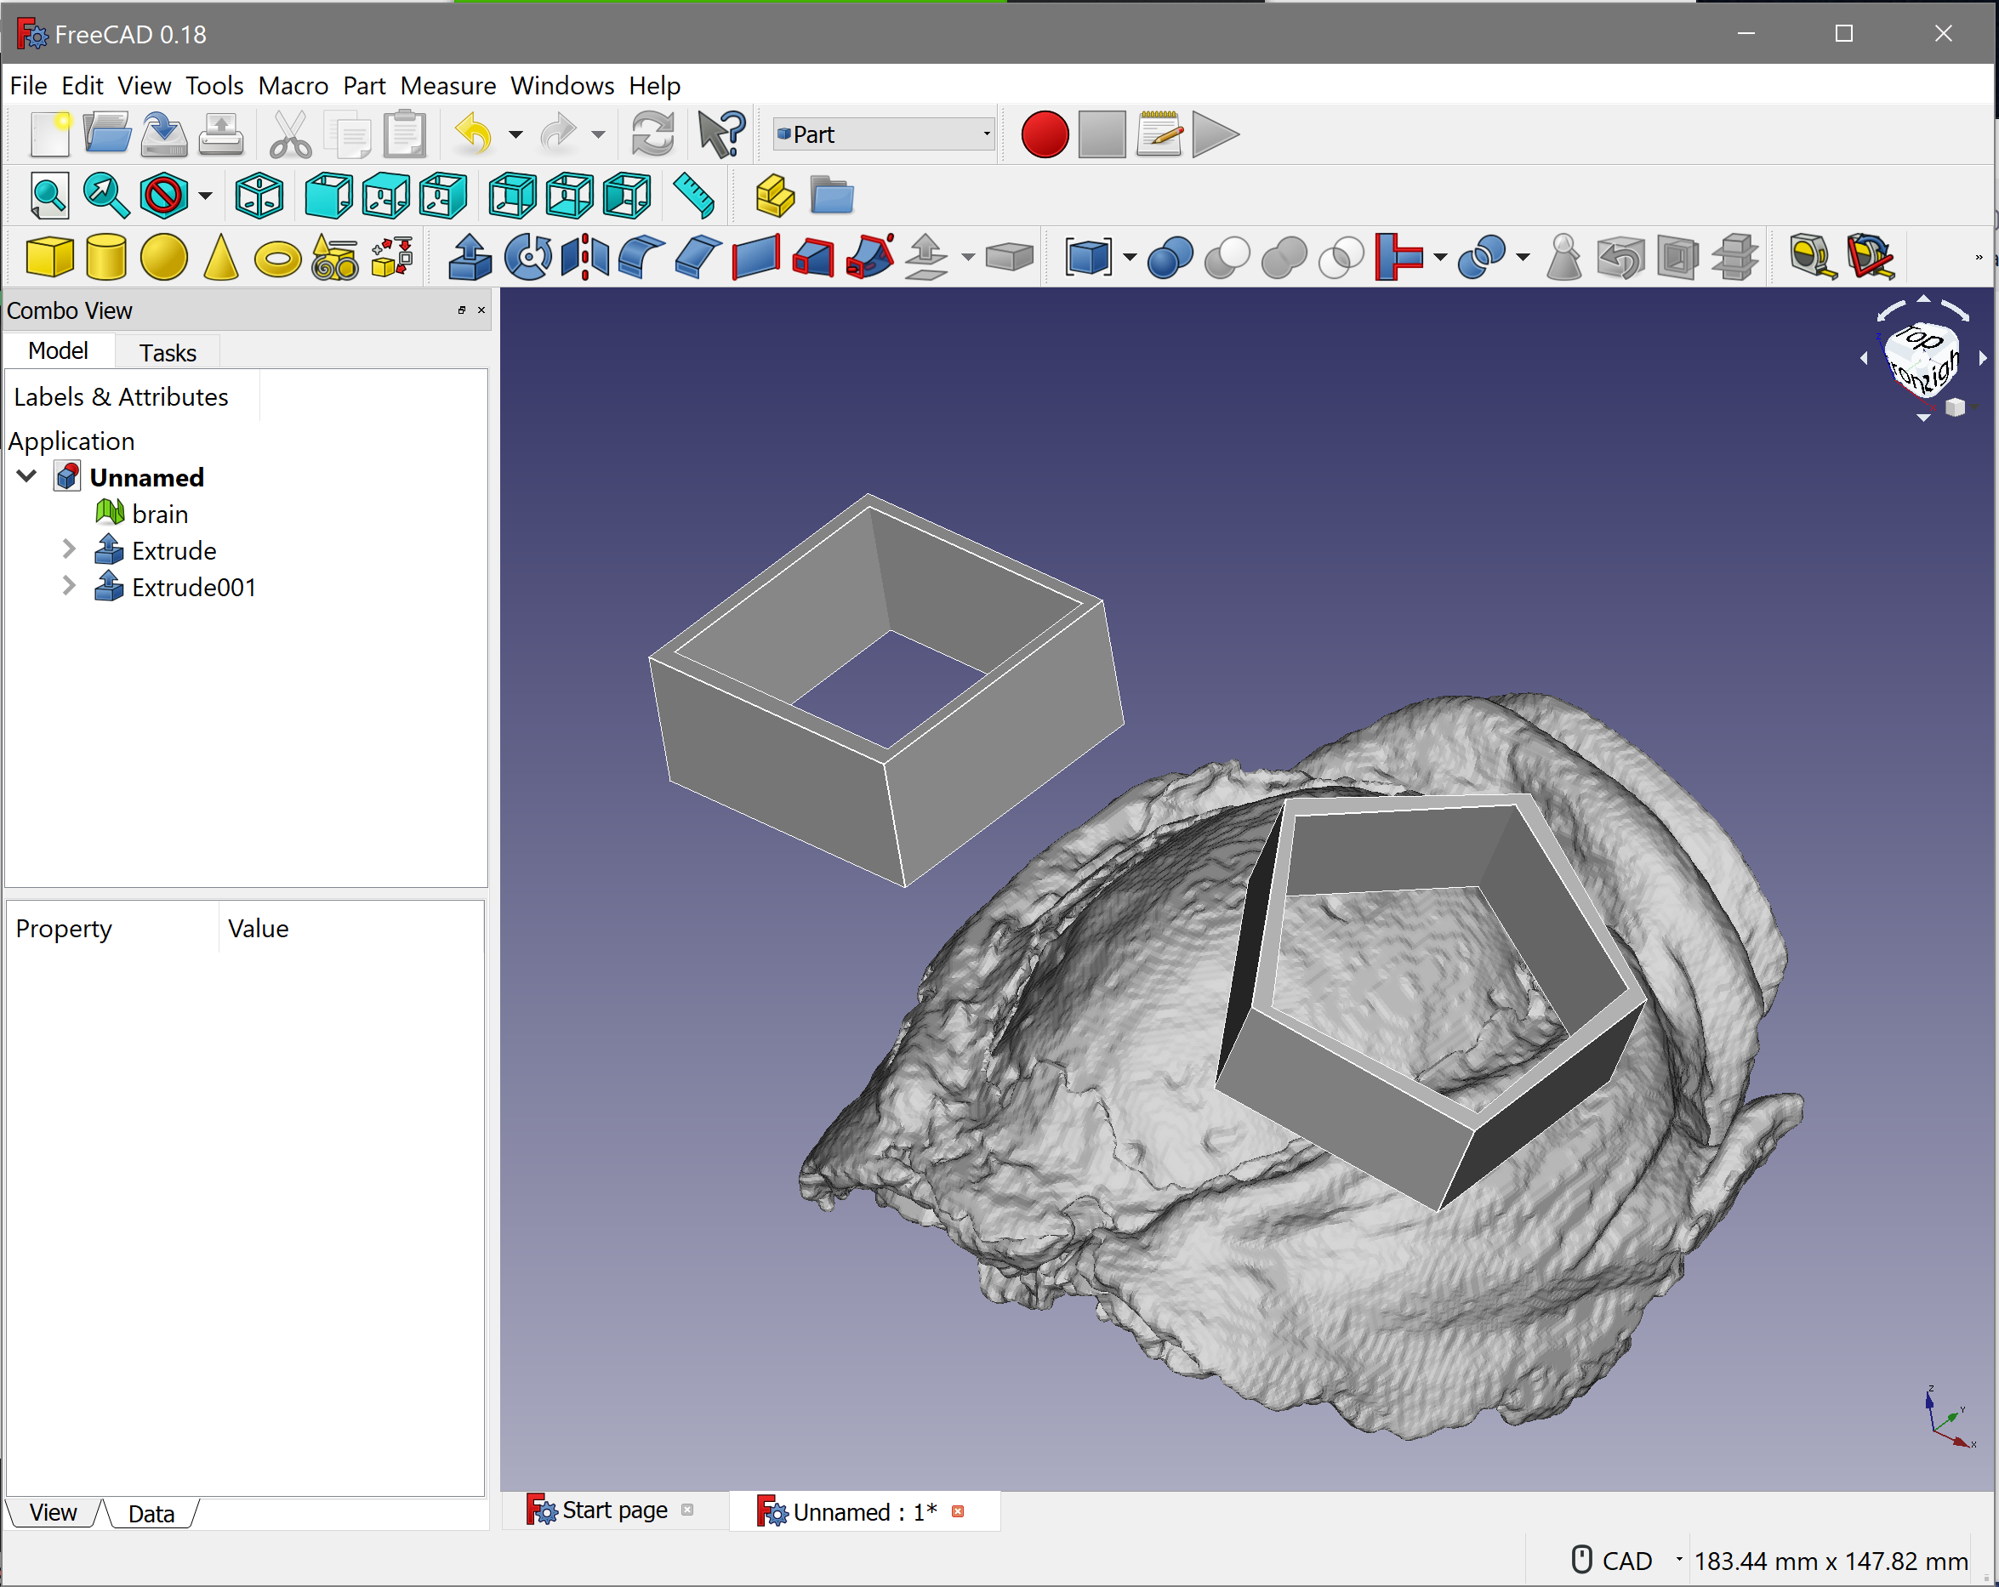
Option 2. Add arbitrary chambers/grids with CAD; need to redesign Planner based on ITK-SNAP and FreeCAD
Draw chambers and grids in CAD software.

